Slide 1
Double materiality How to get started
Workshop for FIBS
30.5.2023

Slide 2
Program and objectives
Opening & getting to know
Double materiality – setting the scene (15 min)
Impact materiality
Case: impact materiality, Sofia Overhill, St1
Short break
Group discussion
Financial materiality
Final reflections
12.00 Workshop ends
In this workshop you’ll:
learn what is double materiality
get an understanding on the process and practical steps needed to define the material topics
share experiences, reflections and emerging practices.

Slide 3
How have you defined your material topics for sustainability reporting?
1
We have not defined the material topics
2
We have defined the material topics based on their importance to business and stakeholders
3
We have undertaken impact materiality assessment as per updated GRI standards
4
We have already piloted double materiality assessment

Slide 4
Double materiality
Sharing questions
What questions do you have about CSRD or double materiality that need to be solved
Thinking of CSRD and double materiality, what worries you the most?
Discuss in groups and write your questions and stress factors on post it paper

Slide 5
Double materiality
Setting the scene

Slide 6
CSRD
Some key implications
Applies to all large companies and all companies listed on regulated markets (except micro companies)
Sustainability information as part of the management report
Requirement for verification of sustainability data (limited vs reasonable assurance)
Requirement for value chain information
Double materiality as basis of sustainability requirements
ESRS setting the detailed disclosure requirements

Slide 7



ESRS Standards
Cross-cutting standards
Topical standards
Environment
Social
Governance
ESRS 1 General requirements
E1 Climate change
S1 Own workforce
G1 Business conduct
E2 Pollution
S2 Workers in the value chains
ESRS 2 General disclosures
E3 Water and marine resources
S3 Affected communities
E4 Biodiversity and ecosystems
S4 Consumer and end-users
E5 Circular economy
Notes:
the list of sustainability matters covered in topical ESRS, categorised by topics, sub-topics and sub-sub-topics support the materiality assessment.

Slide 8




Double materiality - what
Impact
Financial
(risks and opportunities)
The organisation
People and the environment

Slide 9
Double materiality - why
Double materiality is needed to:
Confirm which topical standards to report on
Define impacts, risk, and opportunities for reporting on relevant policies, actions, and targets (under various topical standards)
Few direct connections with material topics and disclosure requirements or individual data points.

Slide 10
Double materiality
Change in perspective
The topic is material for sustainability reporting if its material from impact perspective, financial perspective or from both perspectives
Environmental, social and economic impact
Significance for stakeholders
Significance for business
Finacial effects (from sustainability risks and opportunities)

Slide 11
Stakeholder engagement
As per ESRS
Stakeholders are those who can affect or be affected by the company.
ESRS recognizes two main groups of stakeholders:
  Affected stakeholders
  Users of sustainability statements
Affected stakeholders include individuals or groups whose interests are affected or could be affected by company’s s activities and its direct and indirect business relationships across its value chain: employees and workers, suppliers, consumers and end-users, local communities, vulnerable groups.
Nature may be considered as a silent stakeholder.
Engagement with affected stakeholders is central to materiality assessment, including the process to identify and assess the impacts.
Notes:
Users of sustainability statements:
primary users of financial reporting (such as investors, lenders and other creditors), as well as other users like trade unions, CSOs, governments, analysts and academics.

Slide 12
Double materiality - key changes
4. Change in prioritisation and selection of material topics
1. Two perspectives: impact and financial
2. New process and methodology
3. Different purpose for stakeholder engagement

Slide 13
Impact materiality

Slide 14
Impacts according to ESRS
A sustainability matter is material from an impact perspective when it pertains to the undertaking’s material actual or potential, positive or negative impacts on people or the environment over the short-, medium- and long-term time horizons.
Impacts include those caused or contributed to by the undertaking and those which are directly linked to the undertaking’s own operations, products, or services through its business relationships. Business relationships include the undertaking’s upstream and downstream value chain and are not limited to direct contractual relationships

Slide 15

What do we mean with impact
An organisation can have impact on:
Environmental matters
Social matters
Governance matters
Impact can be:
Positive, negative, actual, potential, direct, indirect, short-, medium-, or long-term, intended or unintended
Notes:
actual or potential, positive or negative impacts on people or the environment over the short-, medium- and long-term time horizons

Slide 16
Time horizons
As per ESRS
Short-term
Period adopted by the undertaking as the
reporting period in its financial statements
Medium-term
From the end of the short-term reporting period to five years
Long-term
More than five
Notes:
The undertaking shall use an additional breakdown for the long-term time horizon when impacts or actions are expected in a period longer than five years and the time difference between them is such that an additional breakdown is necessary to provide relevant information to users of sustainability statements.

Slide 17
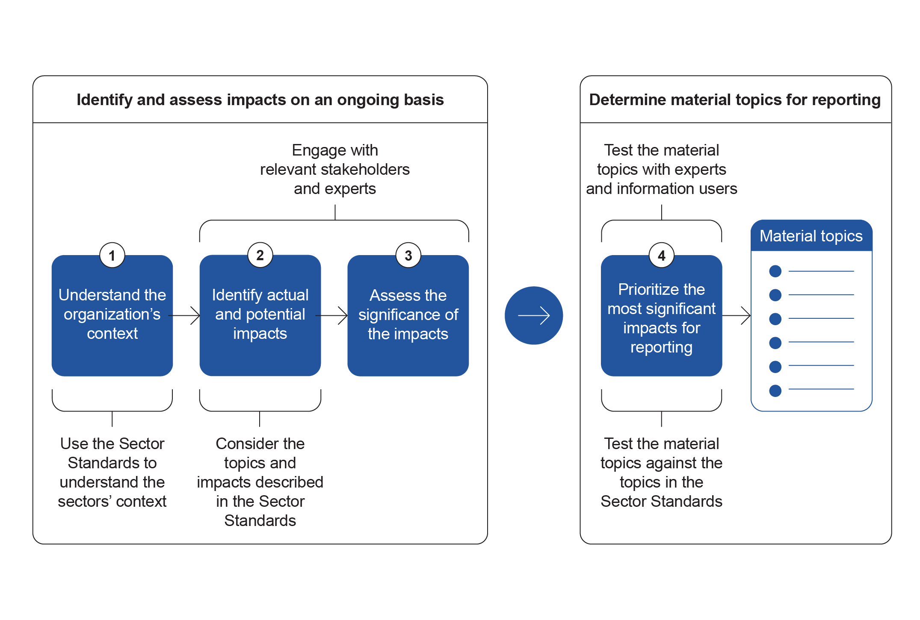
Impact materiality in line with GRI 2021’s updated materiality analysis process
Notes:
Impact materiality in CSRD in line with GRIs 2021 updated materiality analysis process
Step 1 – Understand the organizations context
Step 2 – Identify actual and potential impacts, and here we are expected to analyse actual and potential negative impacts AND also actual and potential positive impacts. The result will be a long list of all of your actual and potential impacts.
Step 3 – In the next step we are supposed to asses the significance of the impacts and this will be done through different combinations of scale, scope, irremediable character and likelihood.
Step 4 – is where we shorten down the list and decide what topics are the material ones to report on.

Slide 18
ESRS topics and sub-topics as a tool to support the assessment
5 environmental topics and 21 sub-topics
E1 Climate change
E2 Pollution
E3 Water and marine resources
E4 Biodiversity and ecosystems
Environment
E5 Circular economy
Adaptation
Pollution of air
Water withdrawals
Direct impact drivers of biodiversity loss
Resource inflows, including resource use
Mitigation
Pollution of water
Water consumption
Climate change, land-use change, direct exploitation, invasive alien species, pollution, others
Resource outflows related to products and services
Energy
Pollution of soil
Water use
Waste
Pollution of living organisms and food resources
Water discharges in water bodies and oceans
Impacts on the state of species
Substances of concern
Habitat degradation and pressure on marine
resources
Impacts on extent and
condition of ecosystems
Substances of very high concern
Land degradation, desertification, soil sealing
Impacts and dependencies on ecosystem services
Notes:
Using this list is not a substitute for the process of determining material matters. This list is a tool to support the undertaking’s materiality assessment. The undertaking still needs to consider its own specific circumstances when determining its material matters.

Slide 19
ESRS topics (and sub-topics) as a tool to support the assessment
4 social topics, 12 sub-topics and 52 sub-sub topics
S1 Own workforce
S2 Workers in the value chains
S3 Affected communities
S4 Consumer and end-users
Working conditions
Working conditions
Communities’ economic, social and cultural rights
Information-related impacts for consumers and/or end-users
Secure employment
Working time
Adequate wages
Social dialogue
Freedom of association and collective bargaining
Work-life balance
Health and safety
Secure employment
Working time
Adequate wages
Social dialogue
Freedom of association and collective bargaining
Work-life balance
Health and safety
Adequate housing
Adequate food
Water and sanitation
Land-related impacts
Security-related impacts
Privacy
Freedom of expression
Access to (quality) information
Equal treatment and opportunities
Equal treatment and opportunities
Communities’ civil and political rights
Personal safety of consumers and/or end-users
Gender equality and equal pay
Training and skills development
Disabilities
Harassment and violence
Diversity
Gender equality and equal pay
Training and skills development
Disabilities
Harassment and violence
Diversity
Freedom of expression
Freedom of assembly
Impacts on human rights
defenders
Health and safety
Security of a person
Protection of children
Other work-related rights
Other work-related rights
Particular rights of indigenous communities
Social inclusion of consumers and/or end-users
Child labour
Forced labour
Adequate housing
Privacy
Child labour
Forced labour
Adequate housing
Water and sanitation
Privacy
Free, prior and informed consent
Self-determination
Cultural rights
Non-discrimination
Access to products and services Responsible marketing practices
Notes:
the list of sustainability matters covered in topical ESRS, categorised by topics, sub-topics and sub-sub-topics support the materiality assessment.

Slide 20
ESRS topics (and sub-topics) as a tool to support the assessment
1 business conduct topic, and 6 sub-topics
G1 Business conduct
Corporate culture
Protection of whistle-blowers
Animal welfare
Political engagement and lobbying
Supplier relationships
Corruption and bribery
Prevention and detection
Incidents
Notes:
the list of sustainability matters covered in topical ESRS, categorised by topics, sub-topics and sub-sub-topics support the materiality assessment.

Slide 21




Applies to impacts across the value chain
ESRS: In identifying and assessing the impacts, risks and opportunities in the undertaking’s value chain to determine their materiality, the undertaking shall focus on areas where they are deemed likely to arise based on the nature of the activities, business relationships, geographies or other risk factors concerned.
Raw materials
Own operations
Consumption
Suppliers
Logistics
Recycling
Composting
Disposal
Notes:
In identifying and assessing the impacts, risks and opportunities in the undertaking’s value chain to determine their materiality, the undertaking shall focus on areas where they are deemed likely to arise, based on the nature of the activities, business relationships, geographies or other risk factors concerned
In identifying and assessing the impacts, risks and opportunities in the undertaking’s value chain to determine their materiality, the undertaking shall focus on areas where they are deemed likely to arise, based on the nature of the activities, business relationships, geographies or other risk factors concerned

Slide 22



Different degrees of involvement in impacts
ESRS: Impacts include those caused or contributed to by the undertaking and those which are directly linked to the undertaking’s own operations, products, or services through its business relationships (not limited to contractual relationships).
DEGREE OF INVOLVEMENT
I
CAUSE
II
CONTRIBUTE
III
DIRECTLY LINKED
Company
Impacts
3rd party
Impacts
3rd party
Impacts
Company
Company
Example: Impacts on employees’ safety and security
Example: Impacts through supply chain
Example: Links to impacts through services / products
Notes:
Impacts include those caused or contributed to by the undertaking and those which are directly linked to the undertaking’s own operations, products, or services through its business relationships.
A company may cause an adverse impact if it denies workers the right to organize themselves.
A company may contribute to an adverse impact if it provides financing to a construction project that will entail forced evictions or agrees a purchasing order with a supplier whose timeline for completion makes it impossible for the supplier to adhere to international labour standards.
A company’s operations, products or services may be directly linked to an adverse impact through a business relationship if one of its suppliers subcontracts work, without its prior knowledge, to contractors that use forced labour.
In this last example, the company has not caused or contributed to the issue, but once made aware of it, it still has a responsibility to act to seek to prevent and/or mitigate it

Slide 23




Assessing impacts
Methodology based on GRI, UNGP and OECD Guidelines
Scale
How grave the impact is
Scope
How widespread the impact is (i.e. no of people, extent of environmental damage)
Irremediability
How hard it is to restore the impact to prior state
Likelihood
The chance of the impact happening
+
Severity
In case of a potential negative human rights impact, the severity of the impact takes precedence over its likelihood.
In case of positive impact, only scale, scope, and likelihood are considered.
Notes:
The severity is determined by the following factors:
(a) scale: how grave the negative impact is/how beneficial the positive impact is for people
or the environment;
(b) scope: how widespread the negative/positive impacts are. In case of environmental
impacts, the scope may be understood as the extent of environmental damage or a
geographical perimeter. In case of impacts on people, the scope may be understood
as the number of people adversely affected; and
(c) irremediable character: whether and to what extent the negative impacts could be
remediated, i.e., restoring the environment or affected people to their prior state

Slide 24
Assessment of impacts
Example of criteria
Score | SCALE: How grave the negative impact is? | SCOPE: number of people impacted | IRREMEDIABILITY: The ability to restore to the prior state
1 Minimal | Adverse impact causes slight, temporary harm | Few individuals | The adverse impact can be restored easily
2 Small | Adverse impact challenges meeting life necessities or freedoms | Group of people | The adverse impact can be restored relatively easily
3 Medium | Adverse impact makes it very challenging to meet life necessities or freedoms (but is not life- or health threatening) | Large group of people | The adverse impact is possible to restore but it requires time and effort.
4 High | Adverse impact threatens health and / or relates to a fundamental human / labour right wit impacts on other rights | Large population within industry or region | The adverse impact is difficult to restore due to severity of the damage or systemic, structural nature of it.
5 Universal | Adverse impact is life threatening and / or relates to a fundamental human / labour right with proven amplifying impact on other rights | Entire industry or population or entire vulnerable group | There is no ability to restore the negative impact
Score | Likelihood
1 | Minimal
2 | Small
3 | Medium
4 | Large
5 | Actual

Slide 25
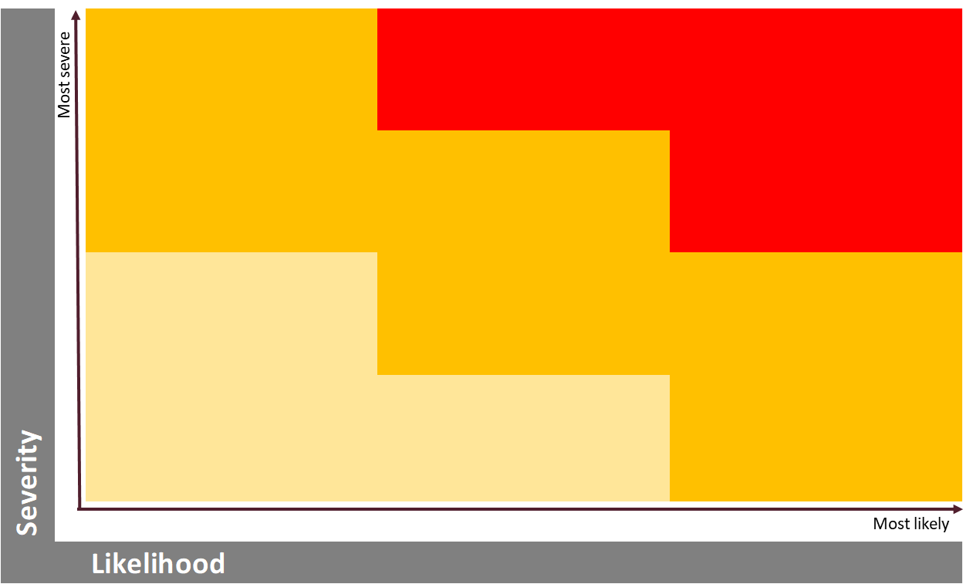
Setting thresholds
ESRS: Appropriate thresholds are necessary to determine which impacts, risks and opportunities are identified and addressed by the undertaking as material and to determine which sustainability matters are material for reporting purposes.
The undertaking shall adopt thresholds to determine which of the impacts will be covered in its sustainability statements.

Slide 26
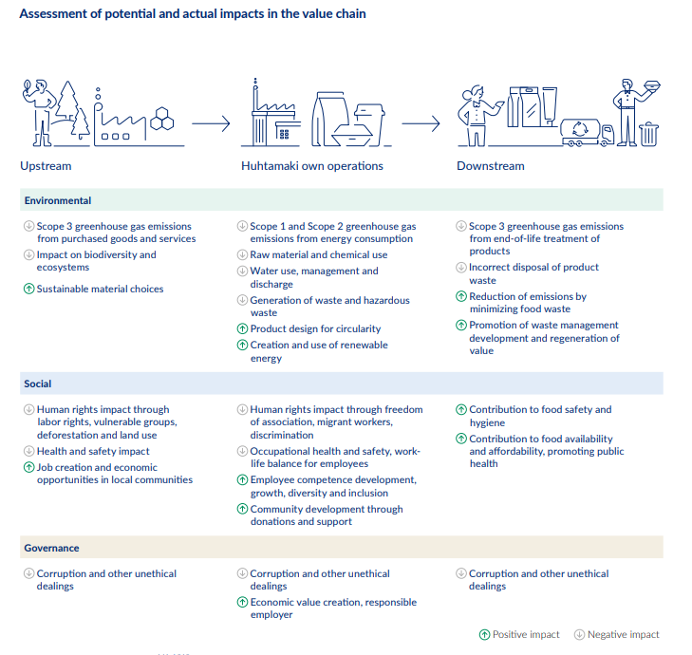
Example of impacts in value chain
Huhtamäki Annual Report 2022

Slide 27
Case: St1 impact materiality

Slide 28

Break
10 min

Slide 29
Discussion in groups

Slide 30
Financial materiality

Slide 31
Impact materiality
An organisation can have impact on:
Environmental matters
Social matters
Governance matters
Impact can be:
Positive, negative, actual, potential, direct, indirect, short-, medium-, or long-term, intended or unintended
Notes:
actual or potential, positive or negative impacts on people or the environment over the short-, medium- and long-term time horizons

Slide 32
But impact goes both ways
Economy
Environment
People, including their human rights
…can have impact on an organisation
Impact can be:
Positive, negative, actual, potential, direct, indirect, short-term, long-term, intended or unintended

Slide 33
Double materiality: Outward and inward impact
Outward Impact
Inward impact
The organisation
People and the environment

Slide 34
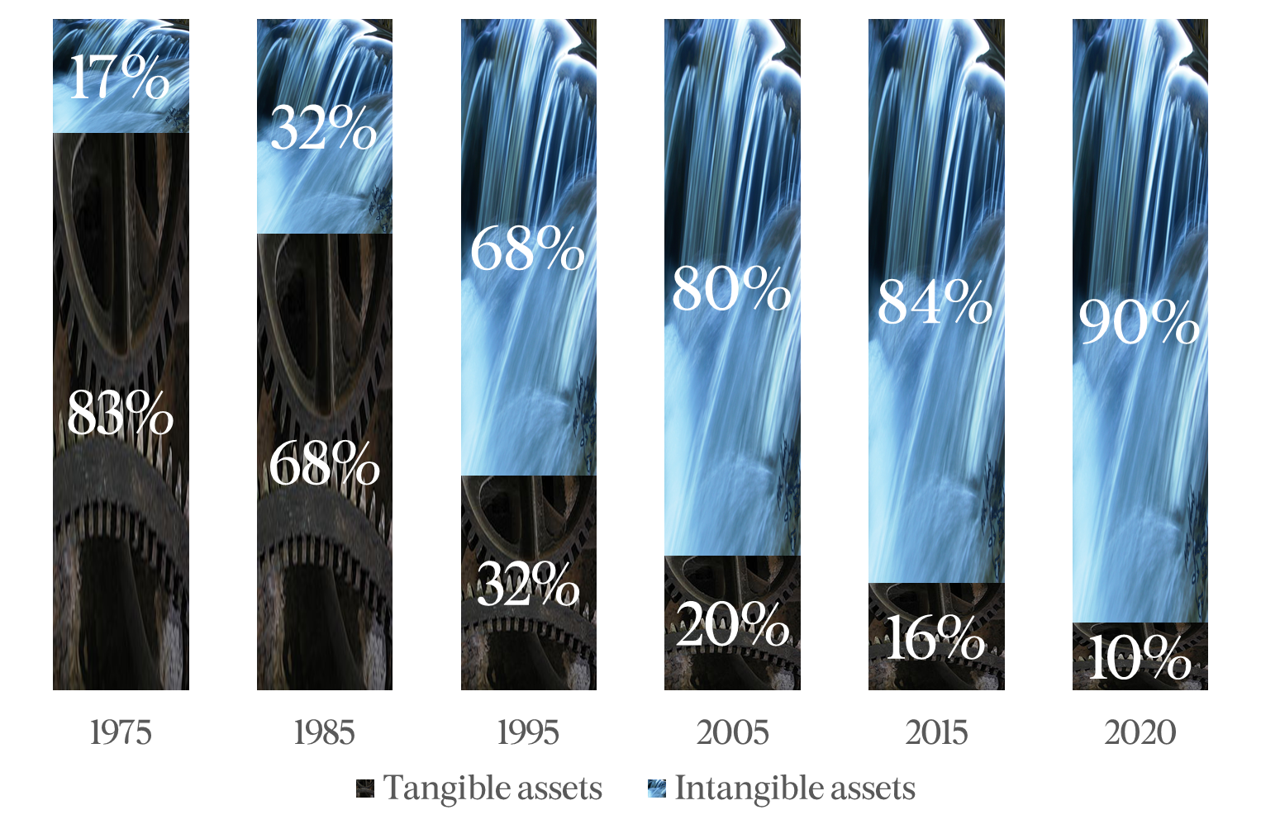
Most of the business value is intangible
Tangible and intangible assets of the S&P 500’s total asset
Source: Ocean Tomo Intangible Asset Market Value Study

Slide 35
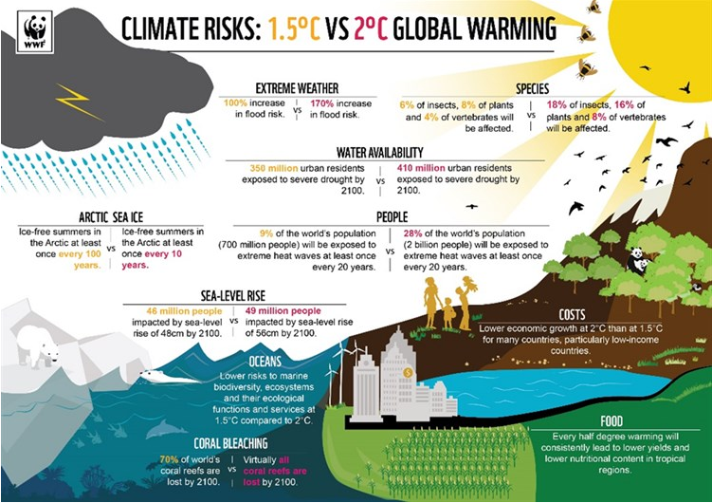
Example: Climate change

Slide 36
Climate change poses risks to business
Value-chain risks
Physical
Prices
Product
Ratings
Reputation
Regulation
External-stakeholder risks
https://www.mckinsey.com/business-functions/sustainability/our-insights/how-companies-can-adapt-to-climate-change

Slide 37
Climate mitigation vs. adaption
ADAPTATION
MITIGATION
Efforts aiming to reduce or eliminate greenhouse gas (GHG) emissions – and/or to remove GHGs from the atmosphere – in order to prevent or reduce significant adverse climate effects.
7%
Efforts aiming to reduce, compensate for or adapt to the adverse impacts that arise from changes in the Earth’s climate
93%
Source: https://www.climatepolicyinitiative.org/publication/global-landscape-of-climate-finance-2021/

Slide 38
Double materiality: Outward and inward impact
Outward Impact
Inward impact
The organisation
People and the environment

Slide 39
Double materiality
Outward impact:
Impact
Materiality
Inward impact:
Financial
Materiality
Sustainability topics that can trigger financial impact
Impact on environment and people
Double Materiality

Slide 40

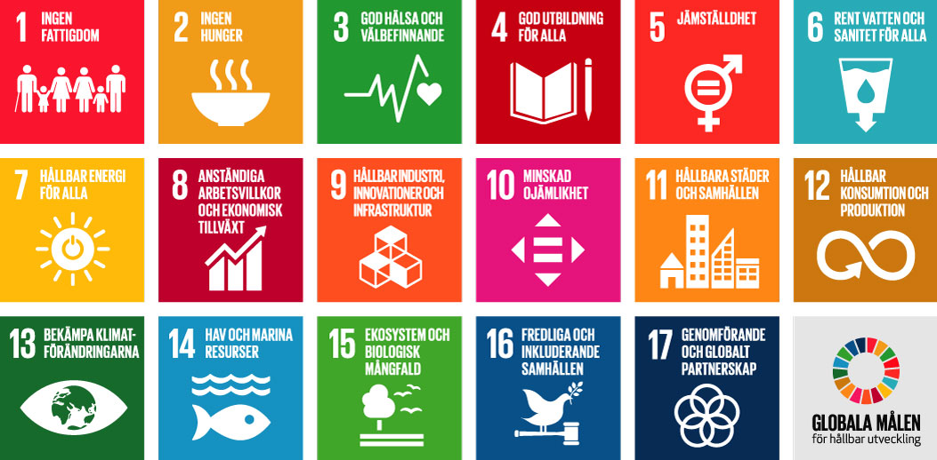











Double materiality: A jungle of reporting requirements and other regulatory development
Outward impact:
Impact
Materiality
Inward impact:
Financial
Materiality
Double Materiality

Slide 41
Financial materiality according to ESRS
A sustainability matter is material from a financial perspective if it triggers or may trigger material financial effects on the undertaking’s development, including cash flows, financial position and financial performance, in the short-, medium- or long-term.
This is the case, in particular, when it generates or may generate risks or opportunities that significantly influence or are likely to significantly influence its future cash flows. Future cash flows, together with other critical factors such as business model, strategy, access to finance and cost of capital, are likely to influence the financial position and financial performance of the undertaking in the short-, medium- or long-term.
Source: 3.5 Financial materiality, ESRS 1, draft November 15th 2022

Slide 42
Financial materiality according to ESRS
Risks and opportunities may derive from past events or
future events and may have effects in relation to:
a) Assets and liabilities already recognised in financial reporting or
that may be recognised as a result of future events; or
b) Factors of value creation that do not meet the financial accounting definition of assets and liabilities and/or the related recognition criteria but contribute to the generation of cash flows and more generally to the development of the undertaking. The latter factors are generally referred to as “capitals” in frameworks promoting a multi-capital approach.
Source: 3.5 Financial materiality, ESRS 1, draft November 15th 2022

Slide 43
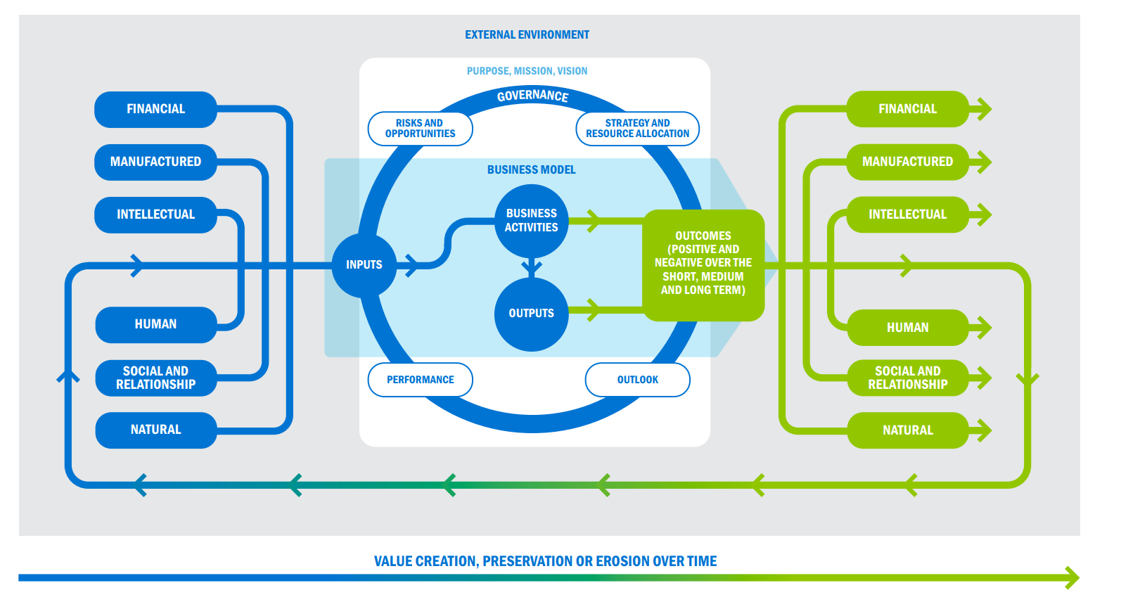
<IR> Integrated reporting – and Integrated thinking
Source: <IR> Framework, page 22

Slide 44

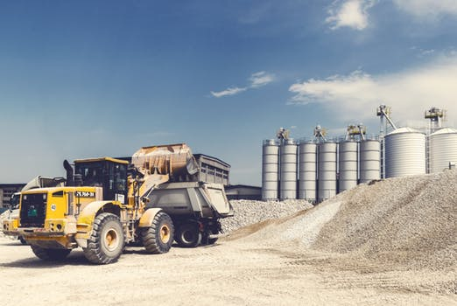




<IR> Integrated reporting – six capitals
Financial
Manufactured
Natural
Human
Social & Relationship
Intellectual

Slide 45
Financial materiality according to ESRS
Risks and opportunities may derive from past events or
future events and may have effects in relation to:
a) Assets and liabilities already recognised in financial reporting or
that may be recognised as a result of future events; or
b) Factors of value creation that do not meet the financial accounting definition of assets and liabilities and/or the related recognition criteria but contribute to the generation of cash flows and more generally to the development of the undertaking. The latter factors are generally referred to as “capitals” in frameworks promoting a multi-capital approach.
Source: 3.5 Financial materiality, ESRS 1, draft November 15th 2022

Slide 46
How to assess financial materiality
The materiality of risks and opportunities is assessed based on
a combination of likelihood of occurrence and potential size of financial effects.
Source: 3.5 Financial materiality, ESRS 1, draft November 15th 2022

Slide 47



Determining financial materiality – some possible steps
Identify inward impacts
1
Desktop: Build gross list
Risks and opportunities as well as current positive and negative impacts (Start with impact materiality issues)
Survey
Identify (and assess) impacts through a survey to internal key stakeholders
Assess inward impacts (financial materiality)
2
Validate (inward) financial materiality
Workshop
(Identify and) assess impacts – likelihood of occurrence and potential size of financial effect
3
Desktop: Make sense
Consolidate results &
make a sanity check
Consolidate with (outward) impact materiality
4

Slide 48
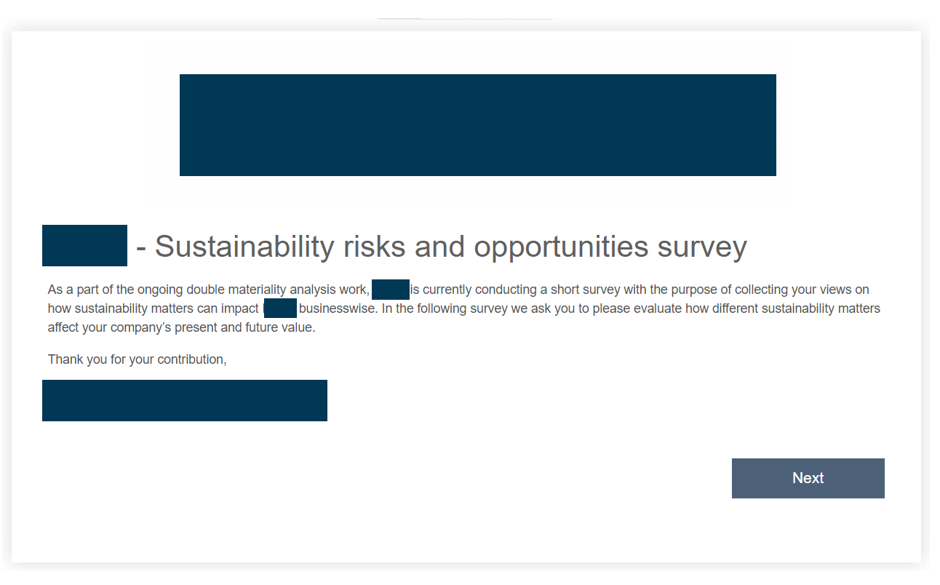
Survey to internal key stakeholders
REAL-LIFE
EXAMPLE

Slide 49
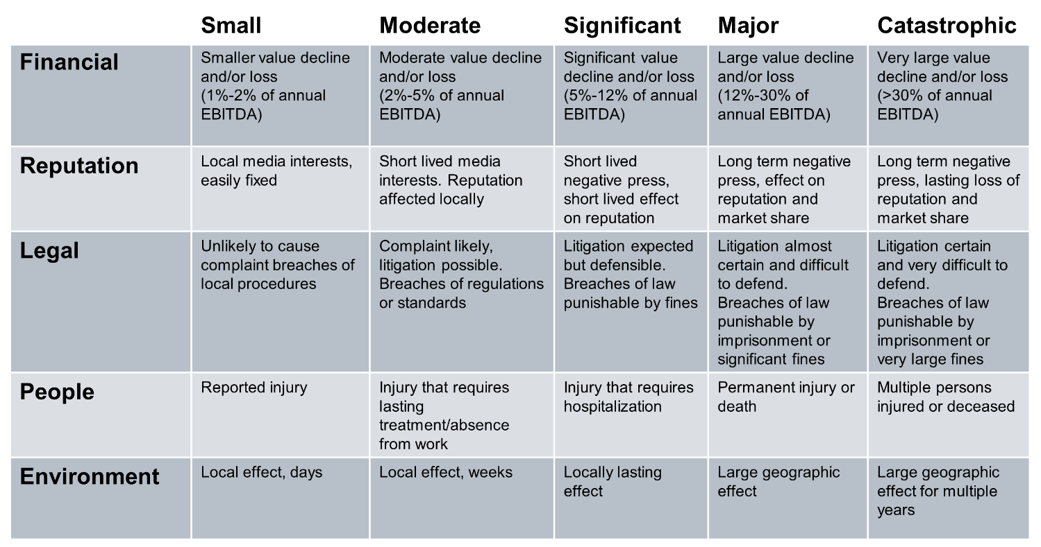
Potential size of financial effect
REAL-LIFE
EXAMPLE

Slide 50
Likelihood of occurrence
REAL-LIFE
EXAMPLE
Level | Likelihood | Explanation
Low | <10% | Less likely than not in ten years
Possible | 10 – 25% | Likely in 4 – 10 years
Likely | 25 – 50% | Likely in 2 – 4 years
High | >50% | More likely than not in one year

Slide 51
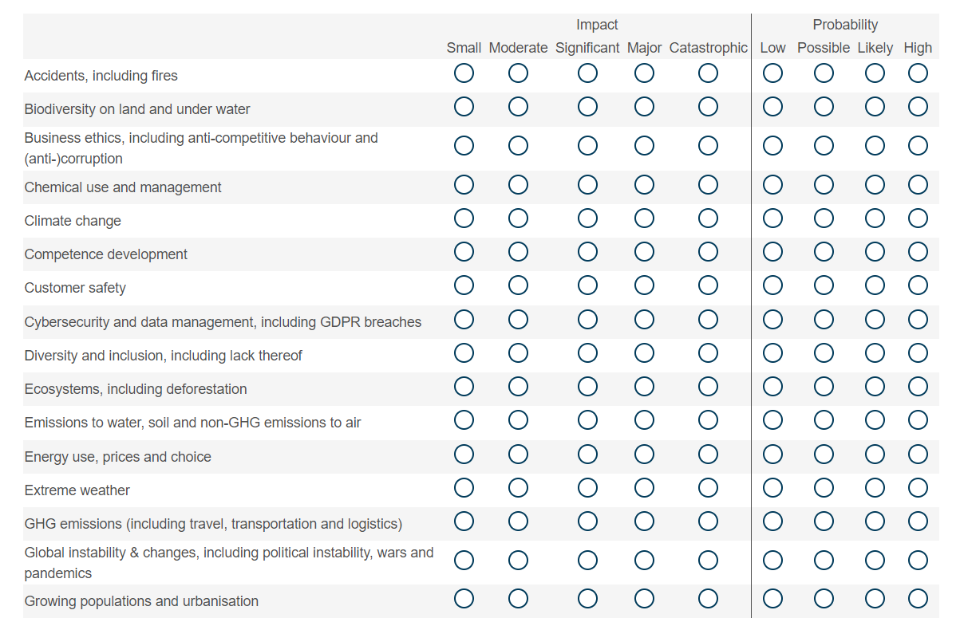
Survey
REAL-LIFE
EXAMPLE

Slide 52
Outward impact - Environment
REAL-LIFE
EXAMPLE
52

Slide 53
Inward impact - Environment
REAL-LIFE
EXAMPLE
53

Slide 54
Double materiality
Outward impact:
Impact
Materiality
Inward impact:
Financial
Materiality
Sustainability topics that can trigger financial impact
Impact on environment and people
Double Materiality

Slide 55
Aggregated impact - Environment
REAL-LIFE
EXAMPLE
Environment
Buildings
Climate change & energy
Ecosystems
Water

Slide 56
Determining financial materiality – some possible steps
Identify inward impacts
1
Desktop: Build gross list
Risks and opportunities as well as current positive and negative impacts (Start with impact materiality issues)
Survey
Identify (and assess) impacts through a survey to internal key stakeholders
Assess inward impacts (financial materiality)
2
Validate (inward) financial materiality
Workshop
(Identify and) assess impacts – likelihood of occurrence and potential size of financial effect
3
Desktop: Make sense
Consolidate results &
make a sanity check
Consolidate with (outward) impact materiality
4

Slide 57
Final reflections

Slide 58





Steps to define material topics
Material topics for sustainability reporting
Phase 1
Mapping impacts, risks and opportunities
Phase 2
Engaging stakeholders
Phase 3
Assessing impacts
Phase 4
Evaluating financial effects of risks and opportunities
Phase 5
Cross-analysing
and prioritising

Slide 59
Thanks for today!

